Slide 1
A015R002L [Hi-pot issue]
Corrective Action Report
Date: 2018/12/11

Slide 2
Content
Issue Description
Root Cause Analysis
Risk Assessment
Corrective Action
Preventive Action

Slide 3
Issue Description
Received customer (Kinpo) feedback that there are 13 pcs of hi-pot test NG in NKG.
The SN is listed as following:
140411063GC2，140411068QC2，14041106XEC2，14041102ELC2，14041106LDC2，14041102MLC2，14041102EBC2，14041106LAC2，14041106VUC2，14041106M6C2，14041106XFC2，14041106C6C2，14041106WAC2.

Slide 4
Root Cause Analysis
Preliminary investigation on these 11pcs returned units and found that all of the units passed the hi-pot test as long as the units are warm-up. The longest one took 30 minutes warm-up with full-loaded. The test was done by CPT FAE together with NKG engineer.
Details of tests condition as following:

Slide 5
Root Cause Analysis
Inspected unit (SN:14041106WAC2) with 200X magnifier on soldering side, found some suspected arcing spot on trace of PCB.

Slide 6
Root Cause Analysis
Inspected the rest of the three unsealed units (S/N: 14041106C6C2/ SN:140411063GC2/SN:14041106LDC2)
Similar finding also observed on the soldering side but they are not all at the same location.

Slide 7
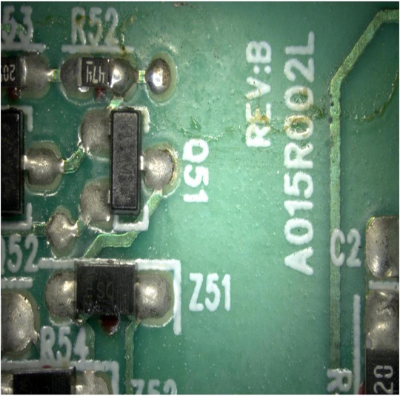
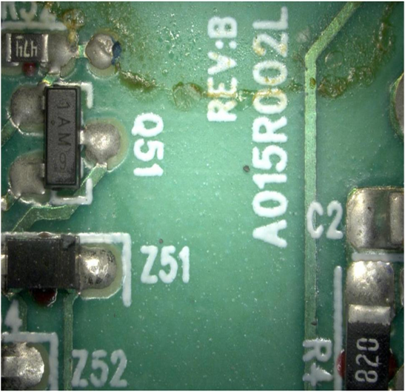
Root Cause Analysis
Open the case of the left 5pcs from NKG and observe them with magnifier.
There’s some flux trail on the soldering side
(SN:14041106M6C2 ; SN:14041106VUC2; SN: 14041106XFC2 ; SN:14041102EBC2; SN:140411068QC2)
SN:14041106M6C2 SN:14041106VUC2

Slide 8
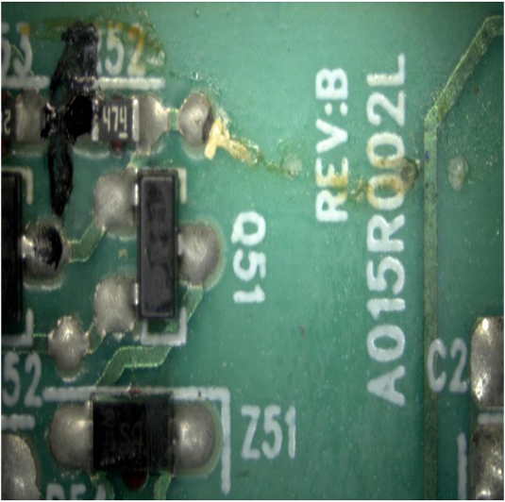
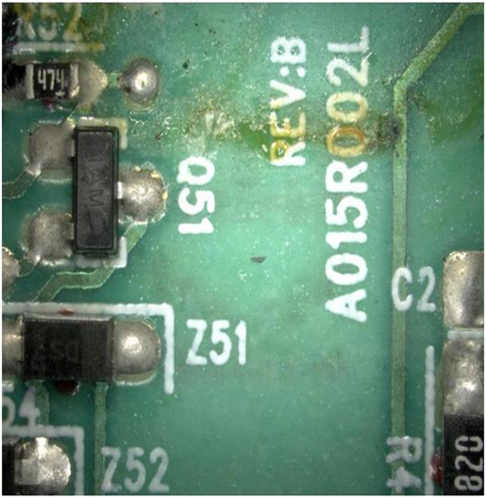
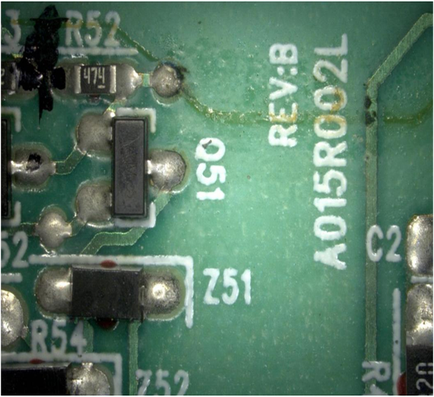
Root Cause Analysis
SN: 14041106XFC2
SN:14041102EBC2
SN:140411068QC2

Slide 9
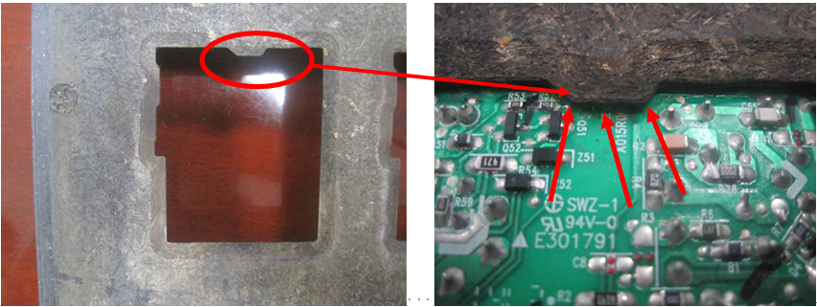
Root Cause Analysis
The HV models use the carrier as the below picture shows since first mass production. The flux may be attached on the PCB along the marking as the picture.

Slide 10
Root Cause Analysis
SN: 14041106XFC2
SN:14041102EBC2
SN:140411068QC2

Slide 11
Root Cause Analysis
Evaluation To Check Whether Flux Cause Hipot Failure
Perform Hipot Test on 10 sample units and record the leakage current.
Apply more flux on the PCB on same 10 samples units as shown on photo (i & ii) and after curing perform Hipot test according to spec, record the leakage current. (Detail see below flow chart)
(i)-Apply more flux before curing (ii)-After curing

Slide 12
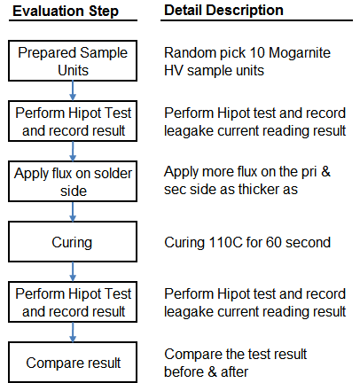
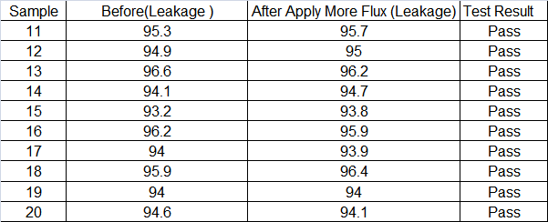
Root Cause Analysis
The test result shows all units passed Hipot Test
（Hipot Spec : Input : 4500Vdc,Leakage:< 600Ua, Test Time: 3 Second）

Slide 13
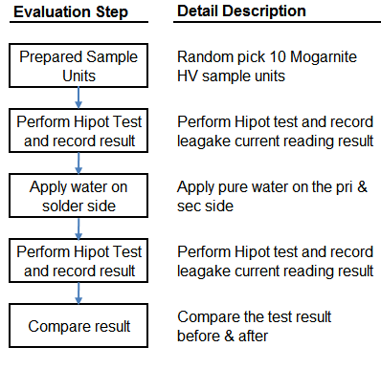
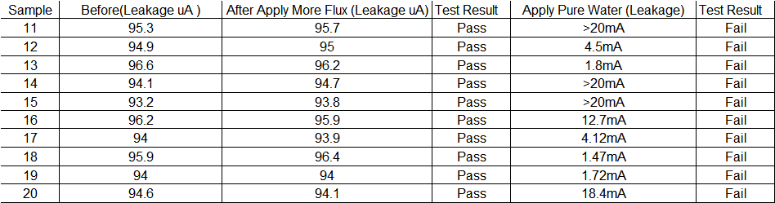
Root Cause Analysis
Evaluation To Check Whether Humidity Cause Hipot Failure
Continue Hipot Test on same 10 units samples above and record the leakage current.
Apply pure water on the PCB on same 10 samples units as shown on photo and perform
Hipot test according to spec, record the leakage current. (Detail see below flow chart) .
The test result shows that the same sample units are failed after apply water.

Slide 14
Root Cause Analysis
PCB Layout

Slide 15
Risk Assessment

Slide 16
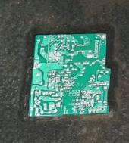
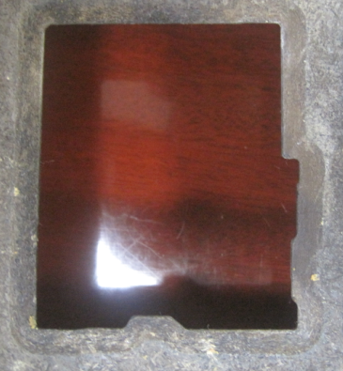
Corrective Action
Modify the carrier to prevent flux staying on safety concern area.
Before
After
Increase the carrier cleaning frequency from 4days per cycle to 2days.

Slide 17
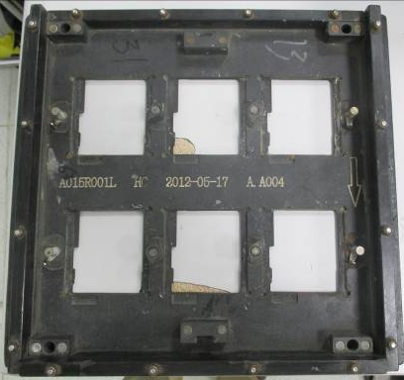
Corrective Action
Classify carriers by 4 type marks in order to make sure each carrier to be cleaned.
Before: Cleaning wave carrier per two days and then record the series no
Weakness:
It is difficult to collect unclean carrier from production line via series no.
It may cause carrier miss cleaning on time.
After :
To classify wave carrier into four type by grinding different ditches on different position

Slide 18
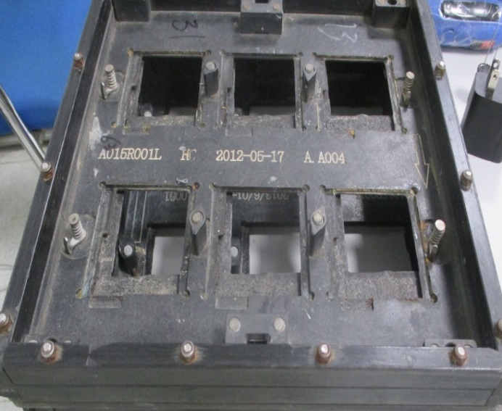
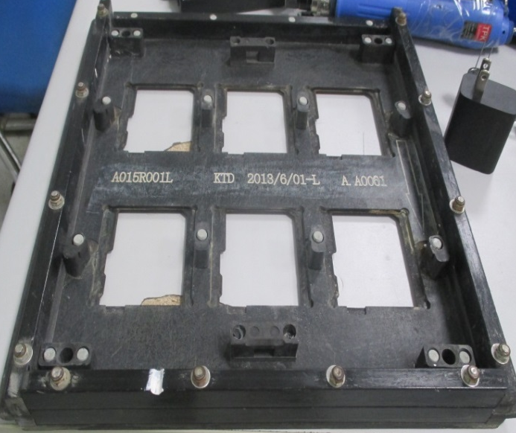
Corrective Action
Advantage:
It is easy to collect unclean carrier from production line via obvious mark.
1st type :
No any mark
2nd type:
One ditch on left side

Slide 19
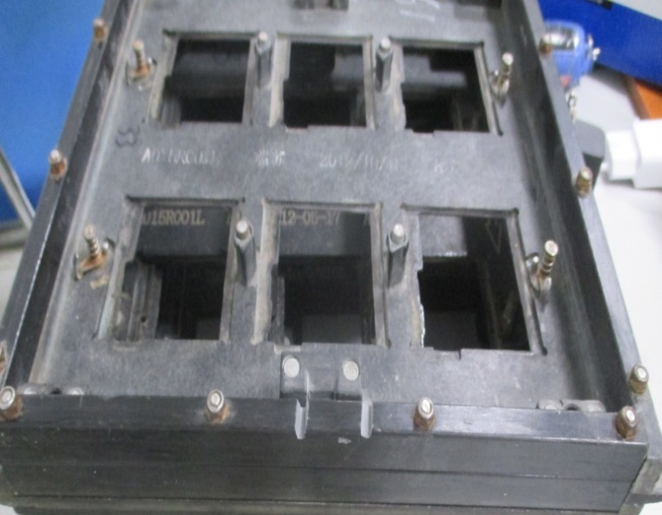
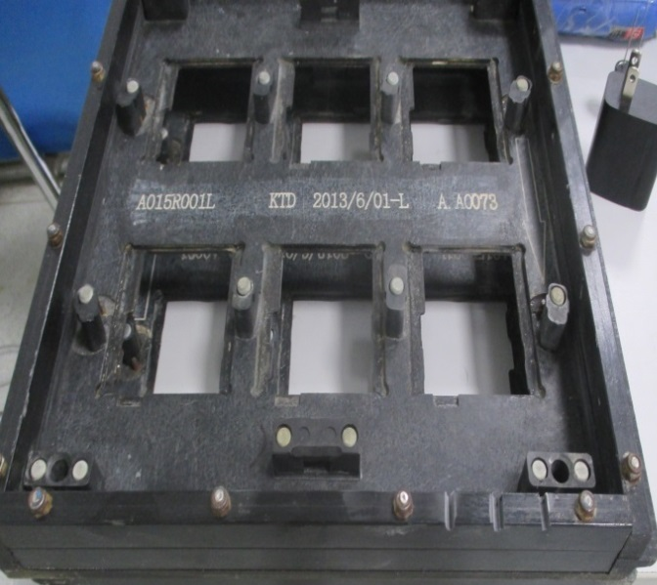
Corrective Action
3rd type:
2 x ditches on center
4th type:
3 x ditches on right side

Slide 20
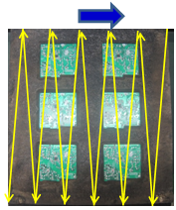
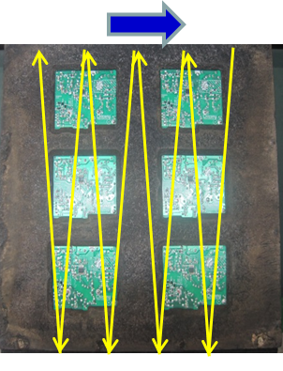
Corrective Action
Change flux spray setting to reduce the spray overlap and total amount of flux spraying.
Before: Distance between sensor and start spraying=560mm
Distance between end spraying and carrier border= 85mm
After: Distance between sensor and start spraying=590mm
Distance between end spraying and carrier border= 135mm
Before
After
CPT will provide GO/NO GO sample for HP approval. Add the flux residue inspection in WI.

Slide 21

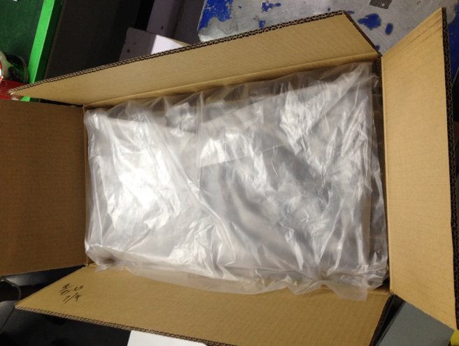
Preventive Action
1.Add PE film in carton box to protect adapter against moisture.
2. Add the desiccant in the carton to protect adapter against moisture.
3. Tape the carton box on 2 sides in additional to the long horizontal center opening, in order
to against moisture.
4.PCB layout cannot have trace between primary side and secondary side.

